Slide 1
WIRELESS EMBEDDED SYSTEM Vehicular Ad hoc Network
Doan Duy, Ph. D.
Email: duyd@uit.edu.vn

Slide 2
Objectives
Acquiring basis of Vehicular Ad hoc Network
Getting known of future traffic perspective and trend

Slide 3
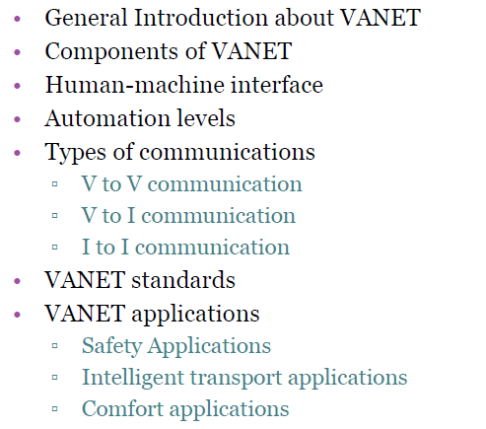
Content

Slide 4
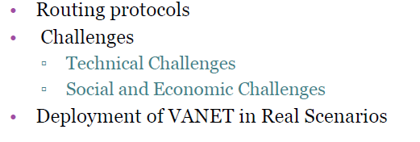
Content (cont.)

Slide 5
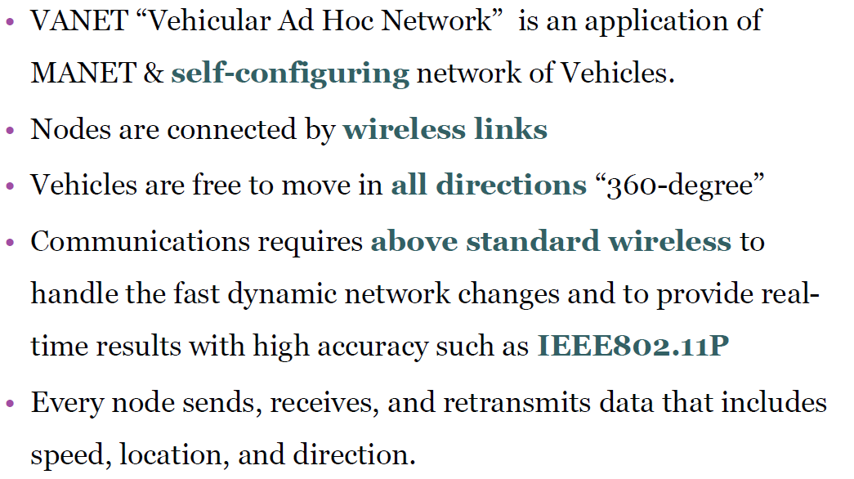
General information about VANET

Slide 6
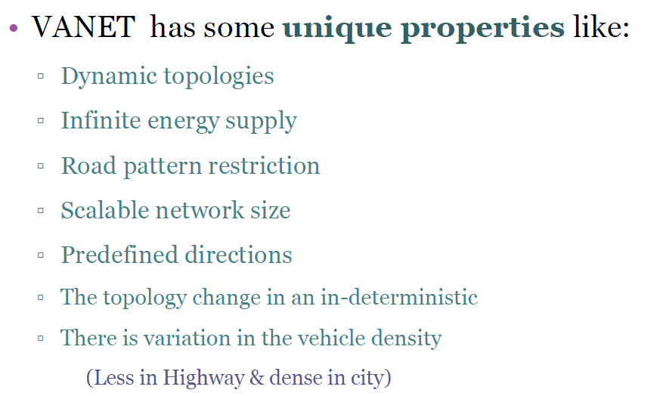
General information about VANET

Slide 7
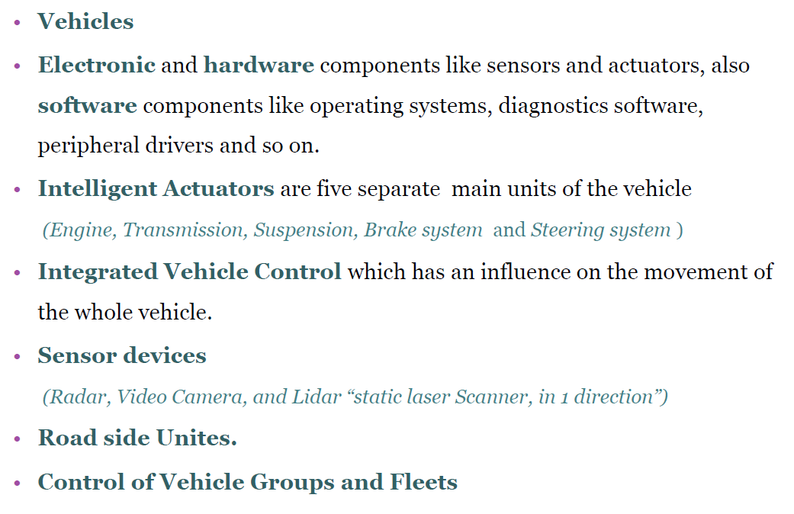
Components of VANET

Slide 8
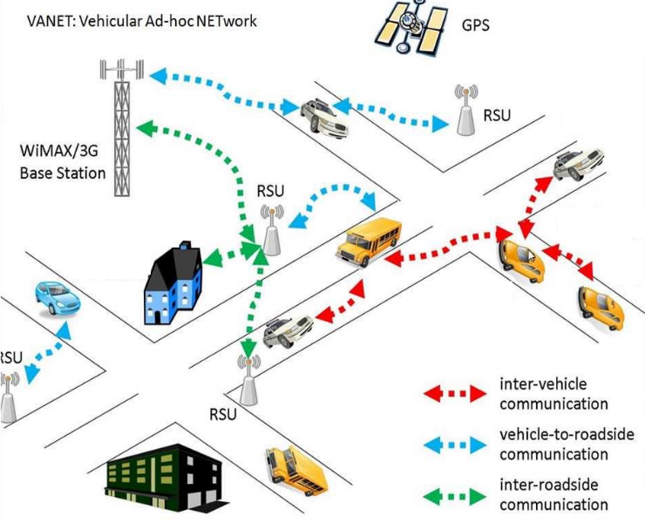
Components of VANET

Slide 9
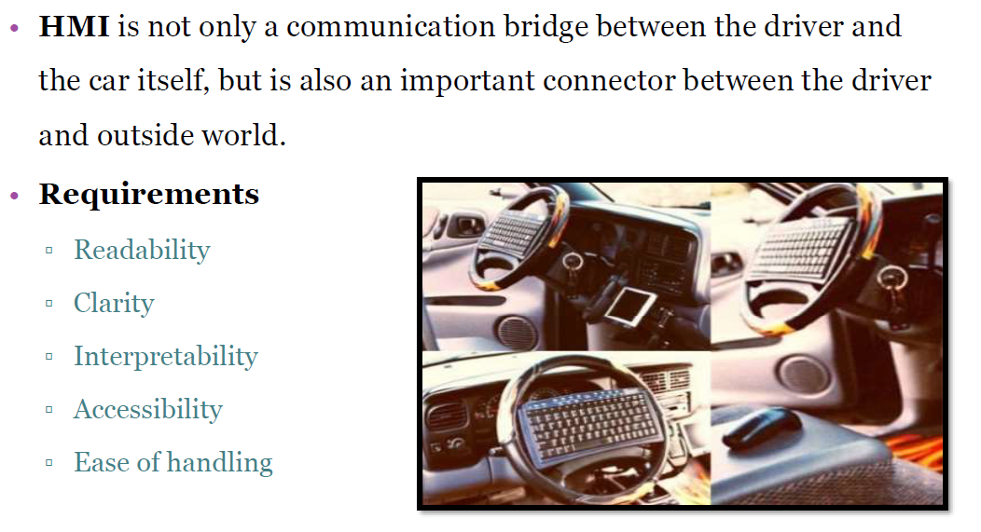
Human-Machine Interface

Slide 10
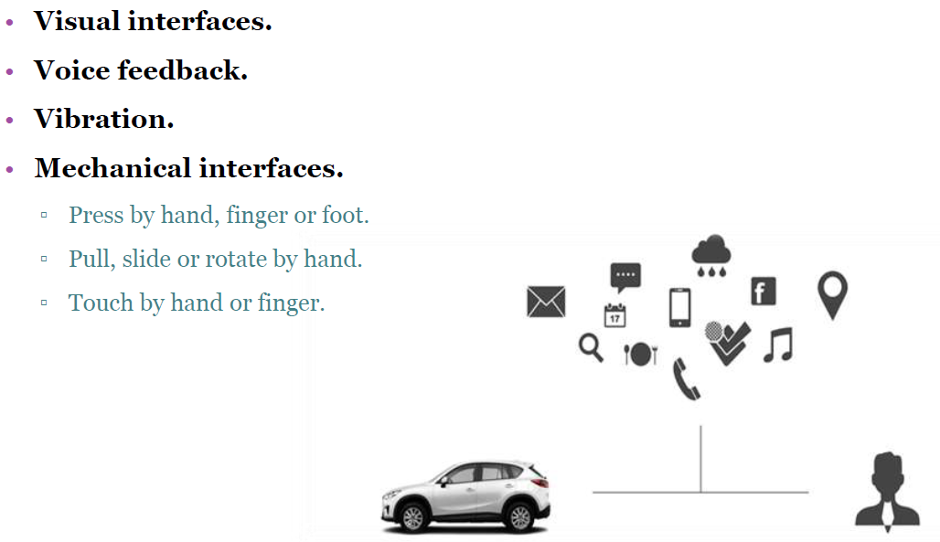
Human-Machine Interface (cont.)

Slide 11
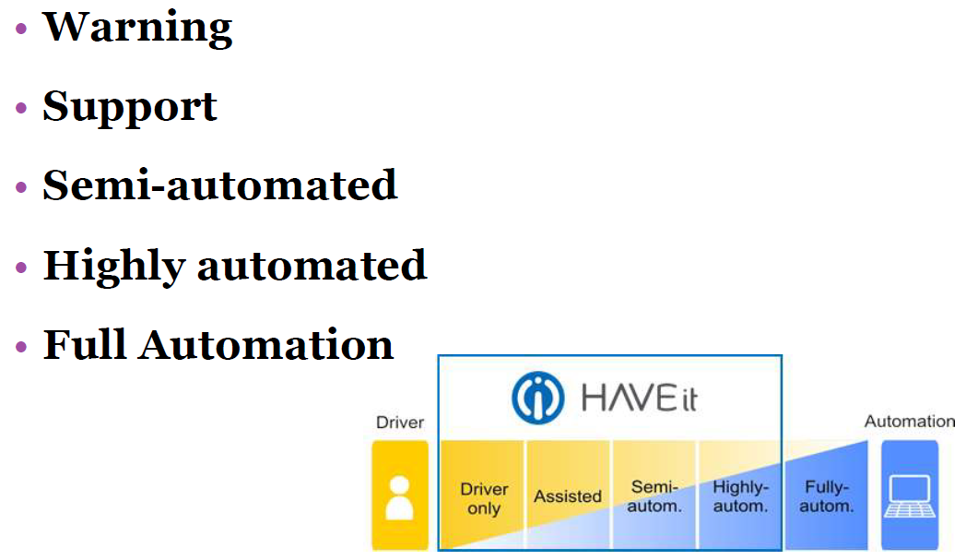
Automation Level

Slide 12
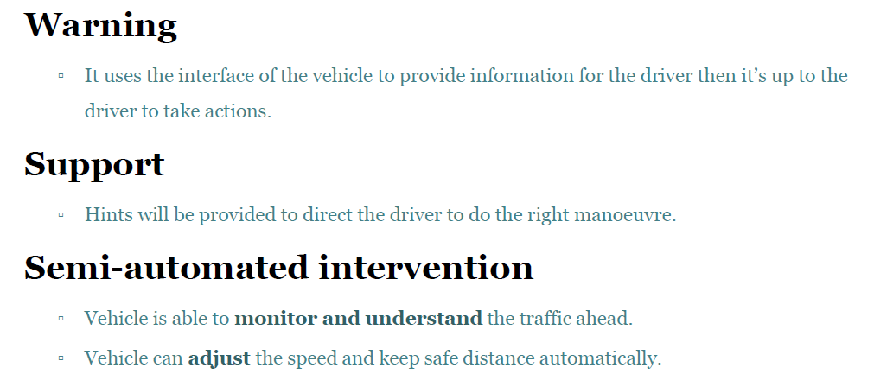
Automation Level (cont.)

Slide 13
Watching Video…
Link: https://www.youtube.com/watch?v=i2nGSUx9r_s&ab_channel=AbduladhimAshtaiwi
Make definitions clear: V2V, DSRC, EEBL, BSW, LCW, FCW, DNPW

Slide 14
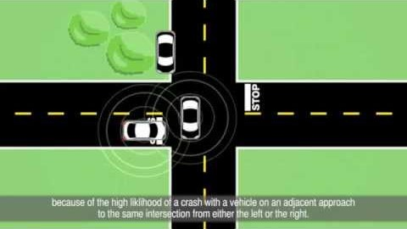

Slide 15
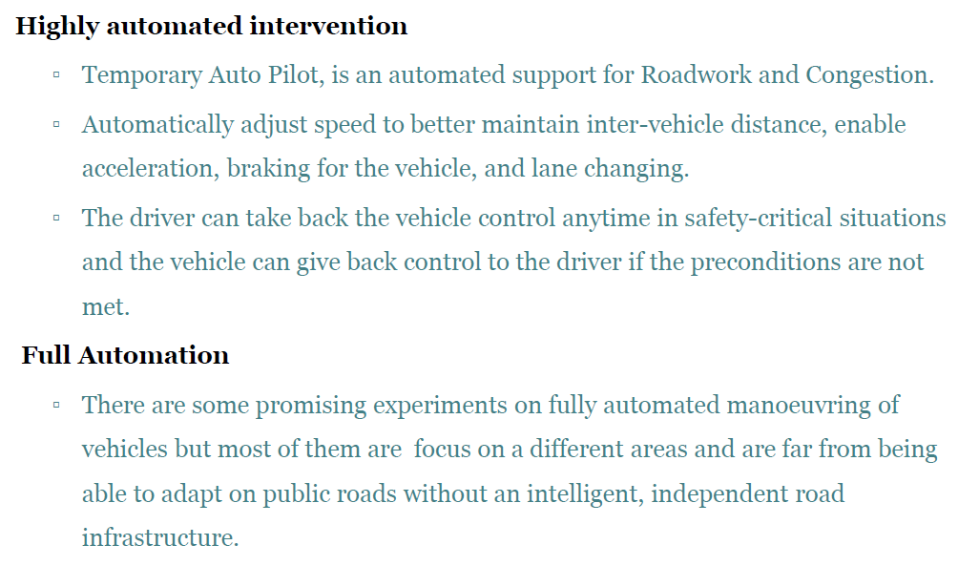
Automation Level (cont.)

Slide 16
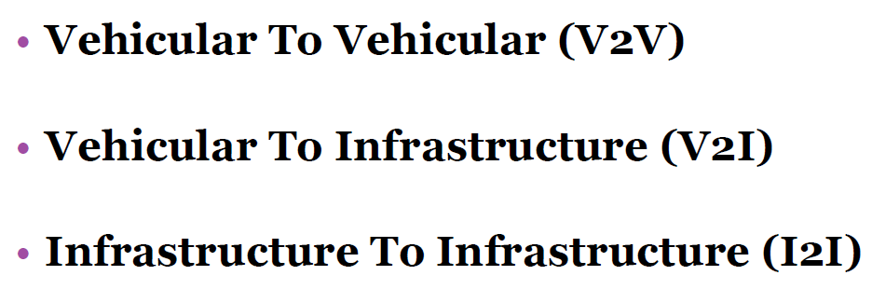
Vehicular Communication

Slide 17
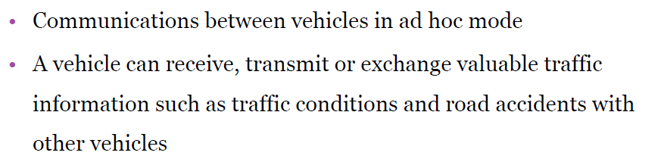
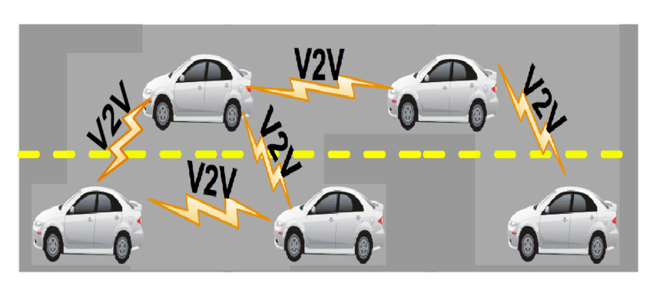
Vehicle-to-Vehicle (V2V)

Slide 18
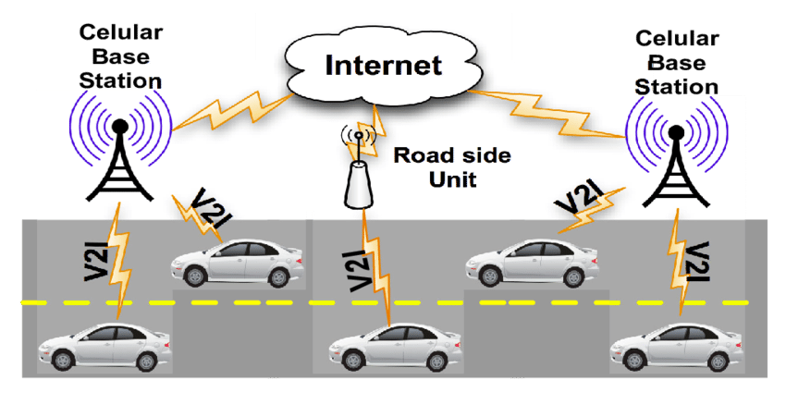
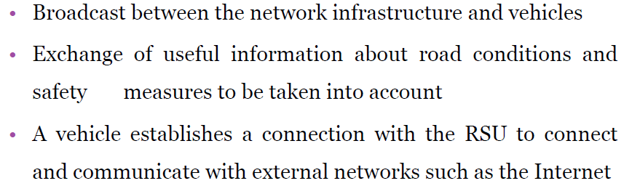
Vehicle-to-Infrastructure (V2I)

Slide 19
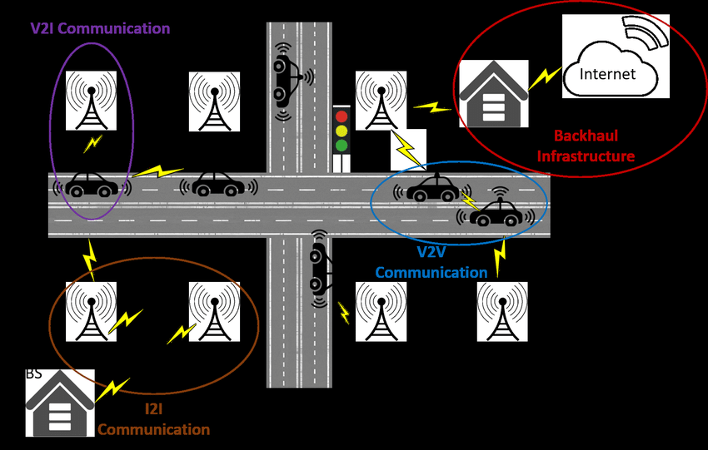
Infrastructure-to-Infrastructure (I2I)

Slide 20
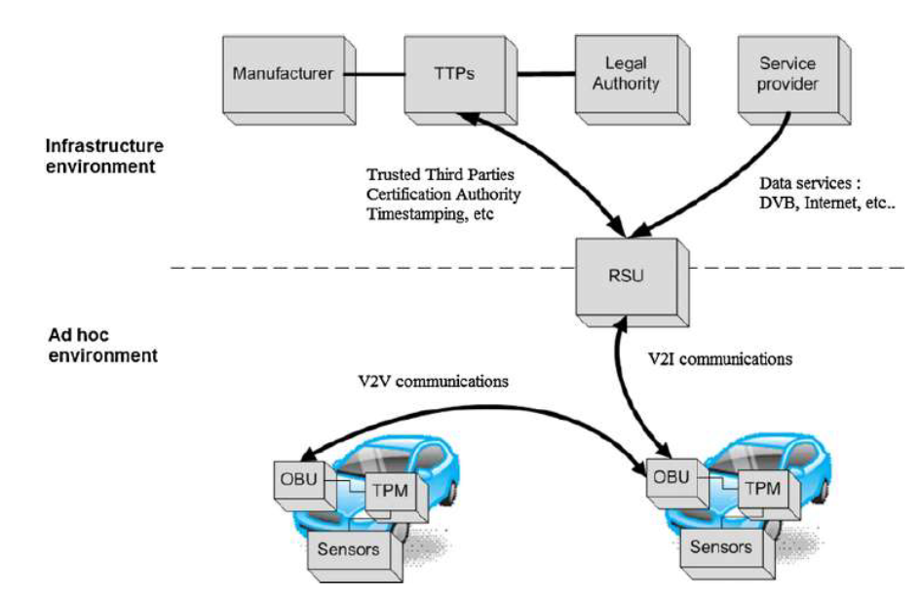
VANET Network

Slide 21
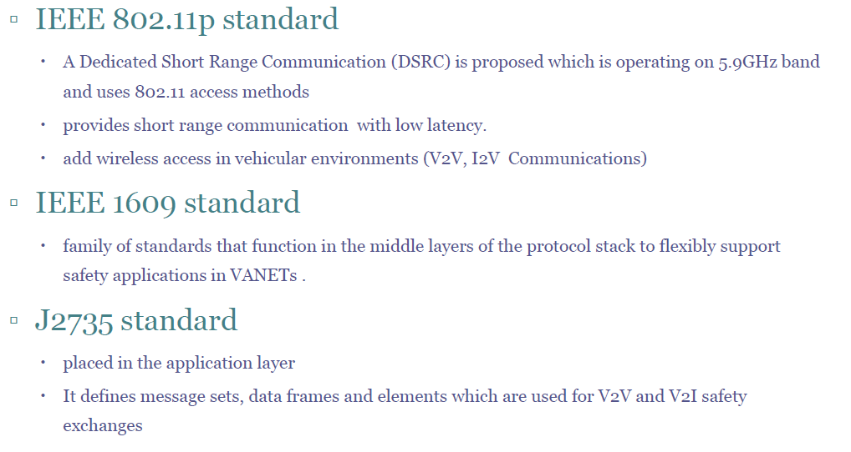
VANET Standards

Slide 22
Watching Video…
Link: https://www.youtube.com/watch?v=0urqaPioLwk&ab_channel=itsjpo
DSRC Technology and communication Standard

Slide 23
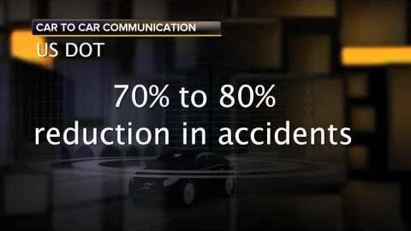

Slide 24
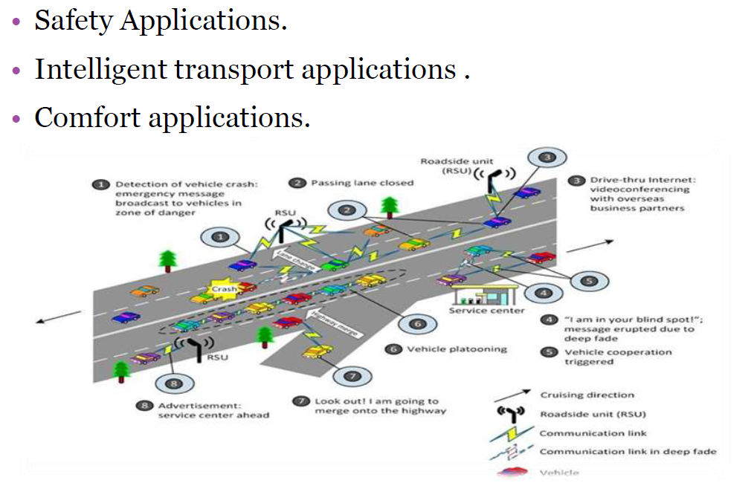
VANET Applications

Slide 25
Watching Video…
Link: https://www.youtube.com/watch?v=Q8Cn47L8FRQ&ab_channel=itsjpo
Discovering VANET Applications

Slide 26
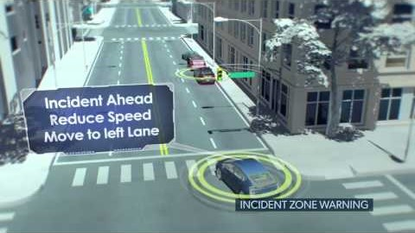

Slide 27
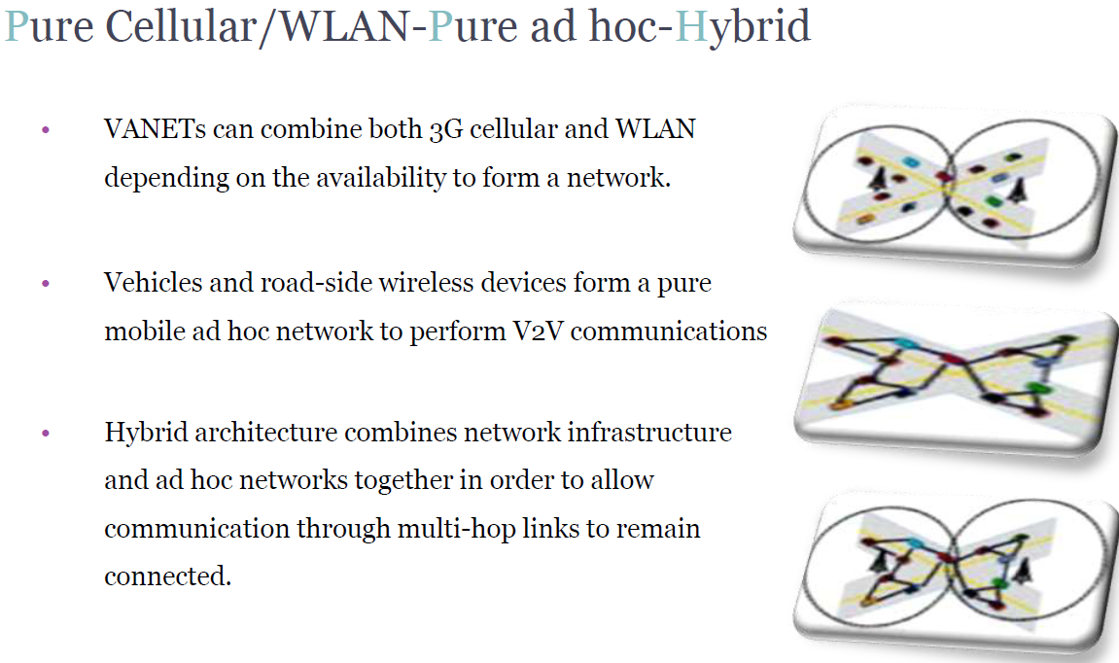
Network Architecture

Slide 28
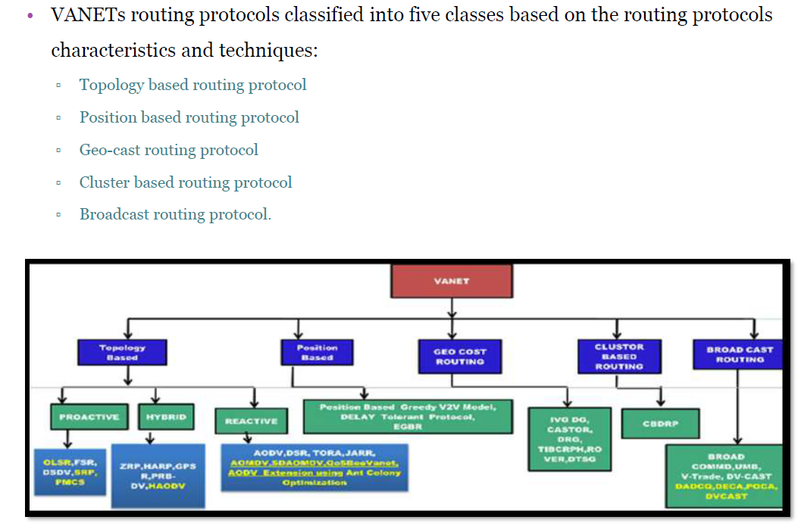
Routing Protocols

Slide 29
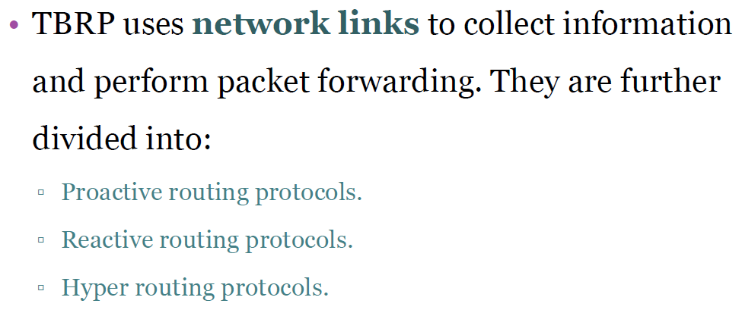
Topology Based Routing Protocol

Slide 30
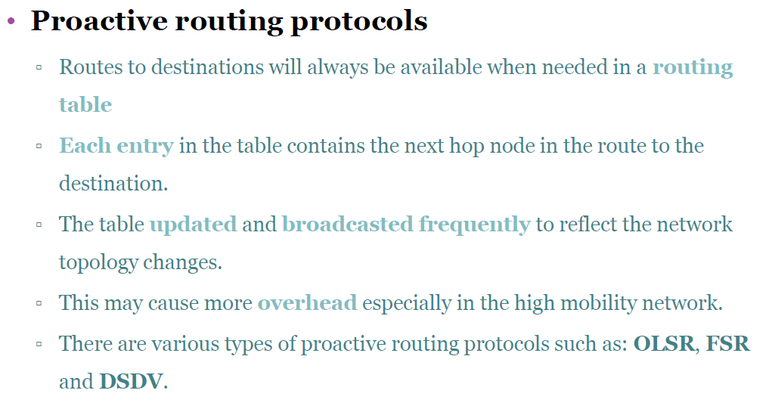
Topology Based Routing Protocol (cont.)

Slide 31
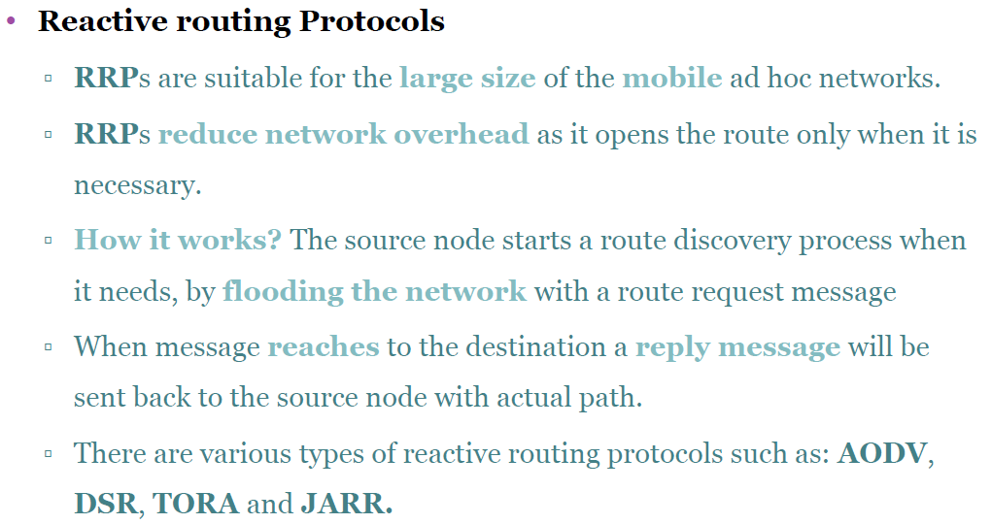
Topology Based Routing Protocol (cont.)

Slide 32
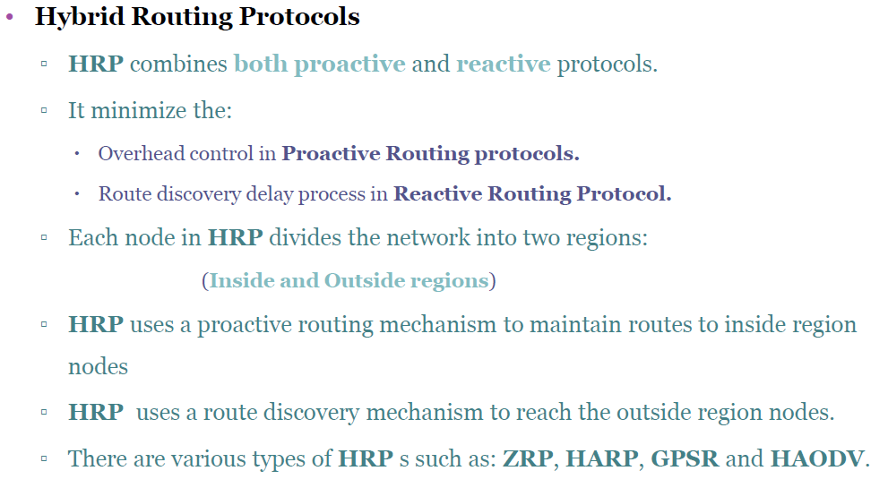
Topology Based Routing Protocol (cont.)

Slide 33
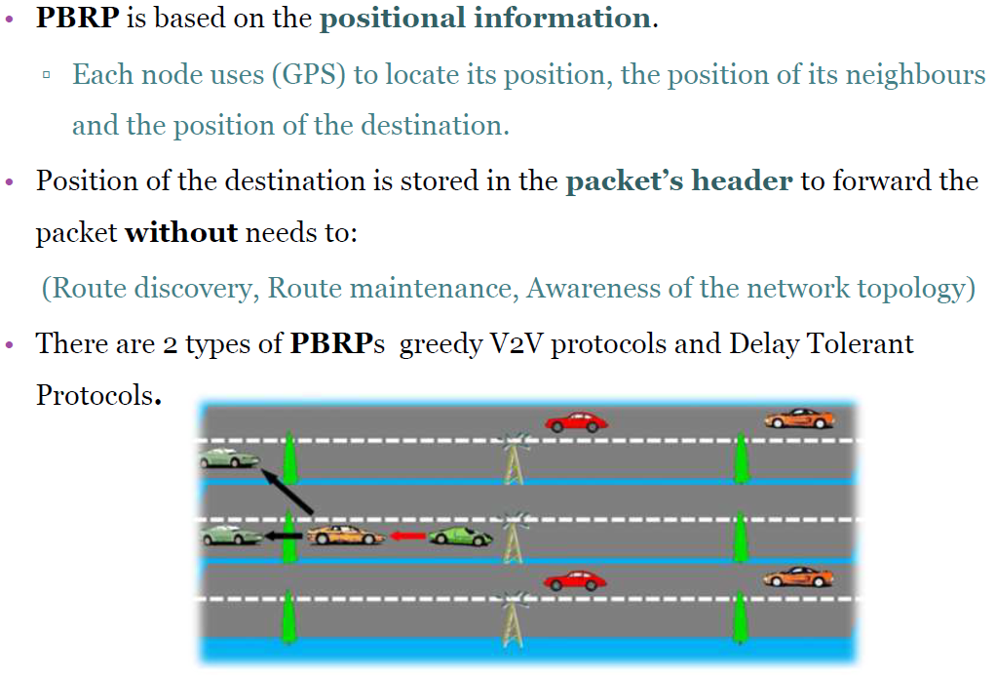
Position Based Routing Protocols

Slide 34
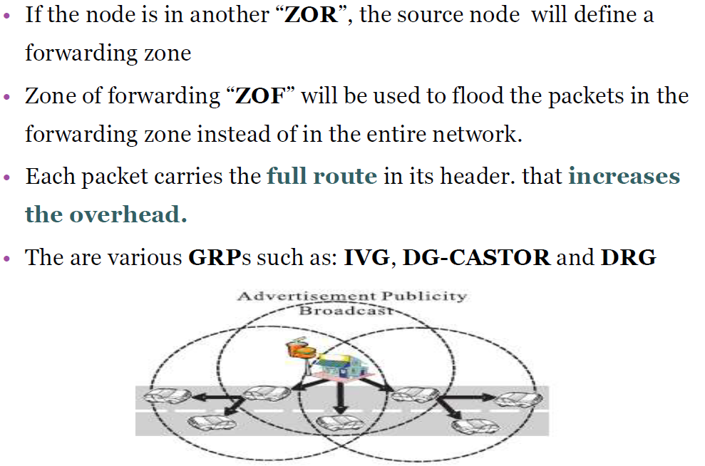
Geo-cast Based Routing Protocol (cont.)

Slide 35
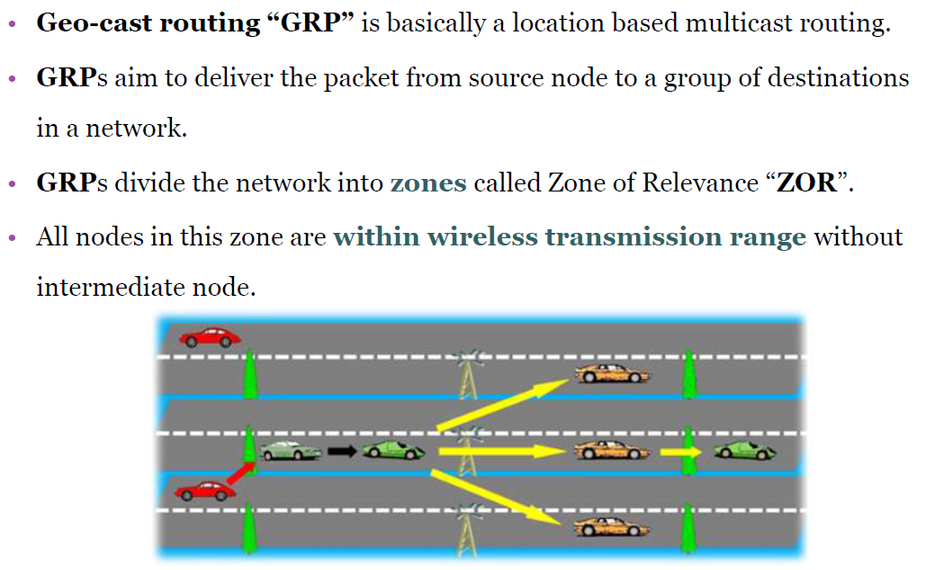
Geo-cast Based Routing Protocol

Slide 36
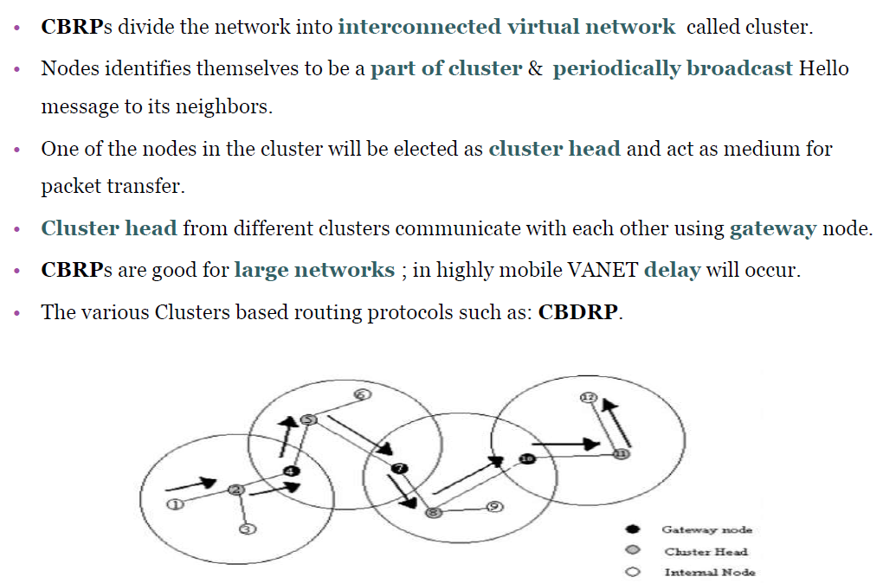
Cluster Based Routing Protocol

Slide 37
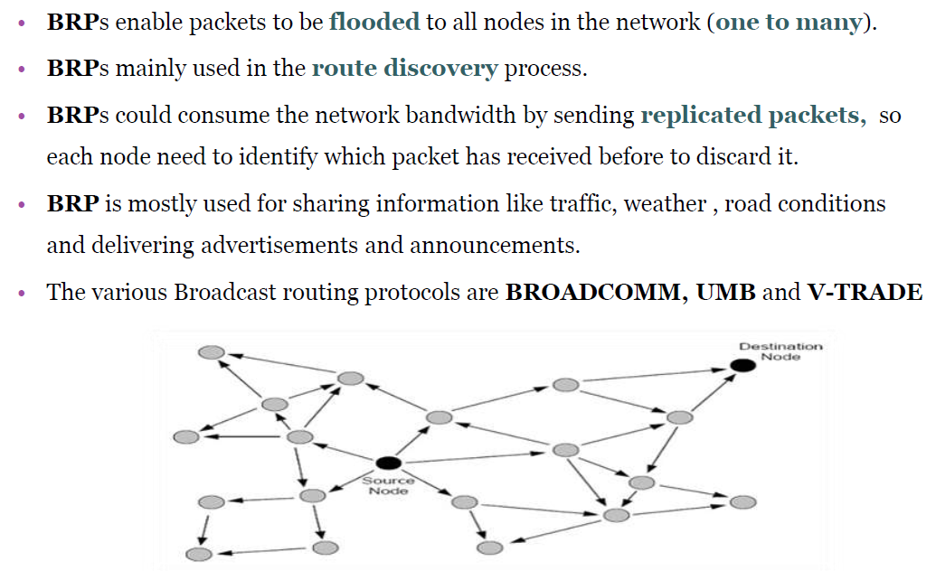
Broadcast Routing Protocol

Slide 38
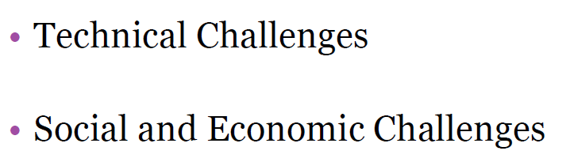
VANET Challenges

Slide 39
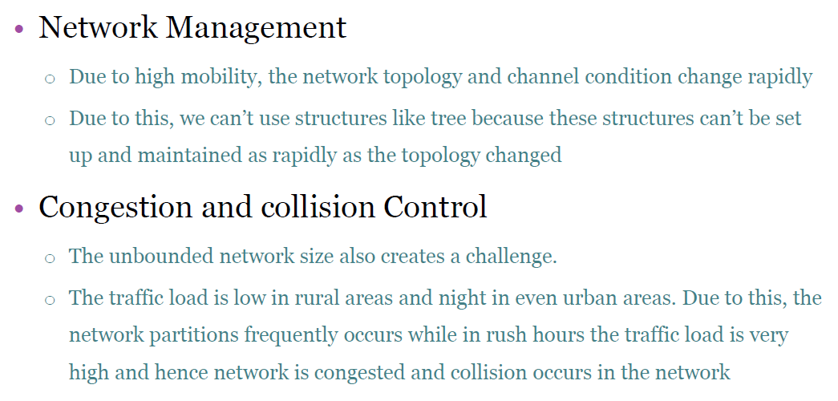
Technical Challenges

Slide 40
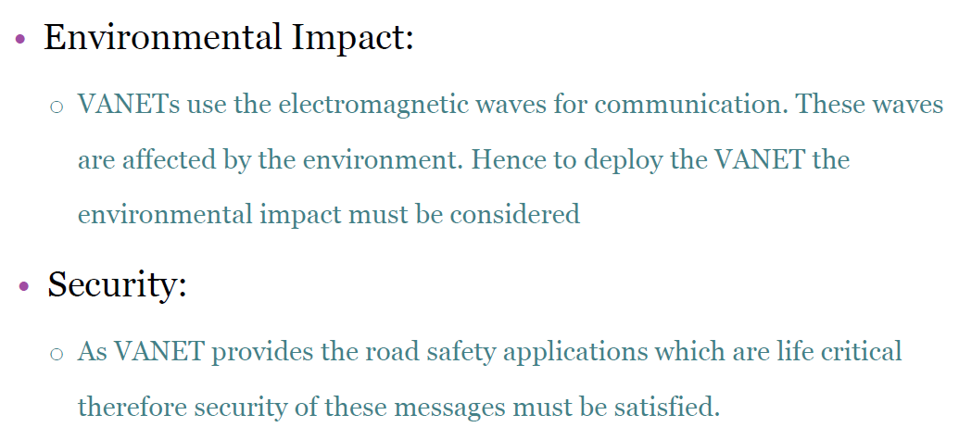
Technical Challenges (cont.)

Slide 41
Social and Economic Challenges
It is difficult to convince manufacturers to build a system that conveys the traffic signal violation because a consumer may reject such type of monitoring. Conversely, consumer appreciates the warning message of police trap. So to motivate the manufacturer to deploy VANET will get little incentive.

Slide 42
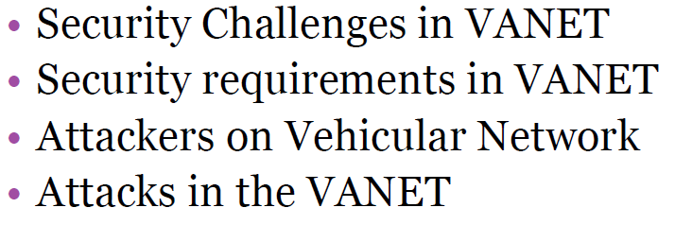
VANET Security Issues

Slide 43
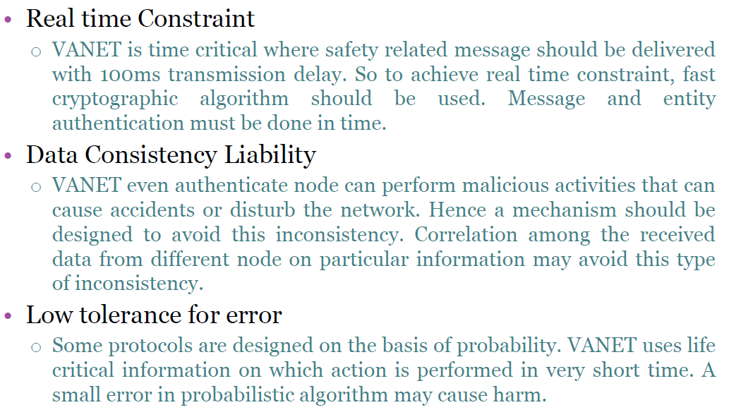
Security Challenges

Slide 44
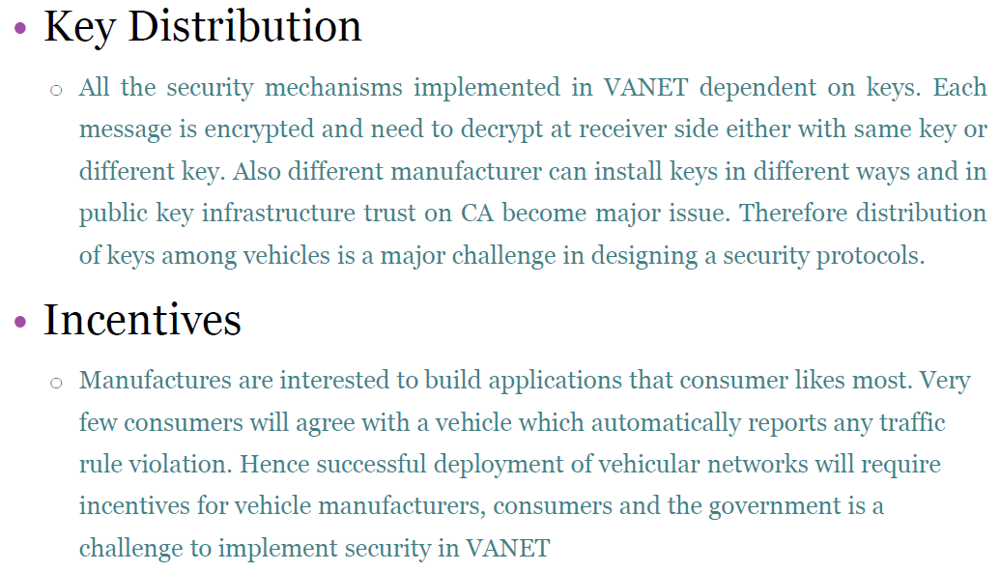
Security Challenges (cont.)

Slide 45
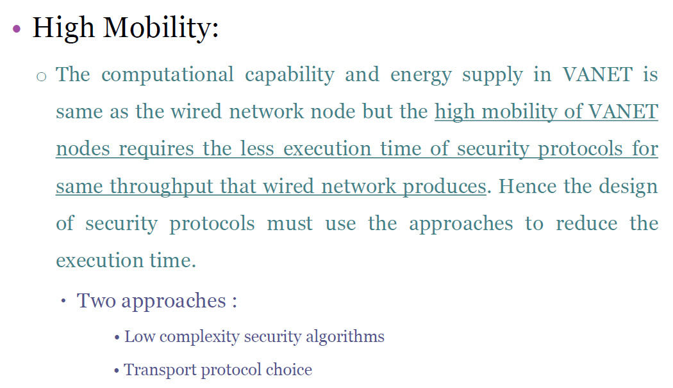
Security Challenges (cont.)

Slide 46
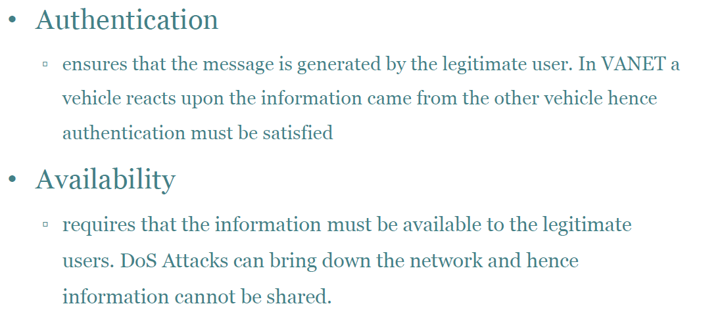
Security Requirements

Slide 47
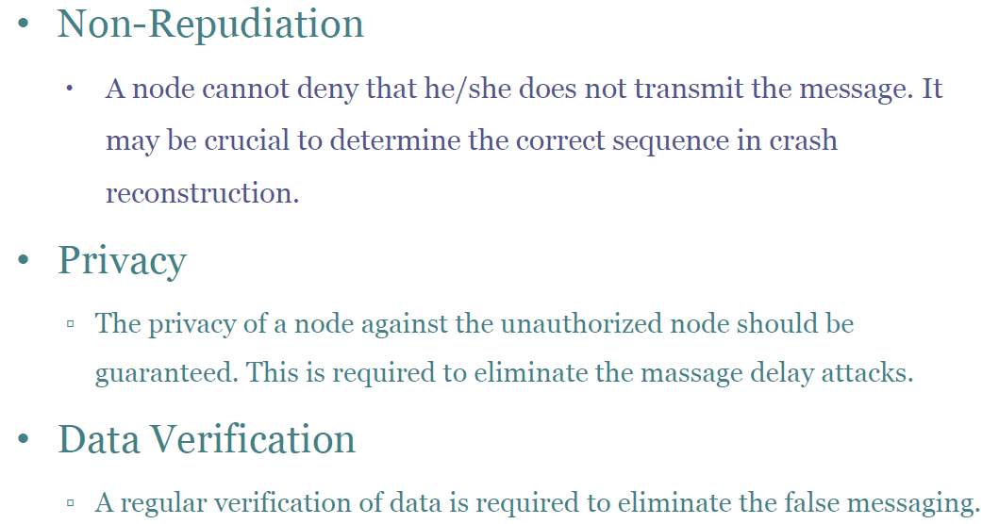
Security Requirements (cont.)

Slide 48
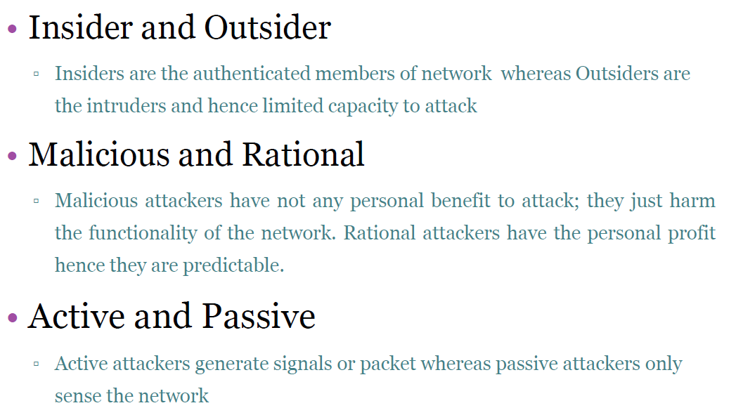
Attackers on VANET

Slide 49
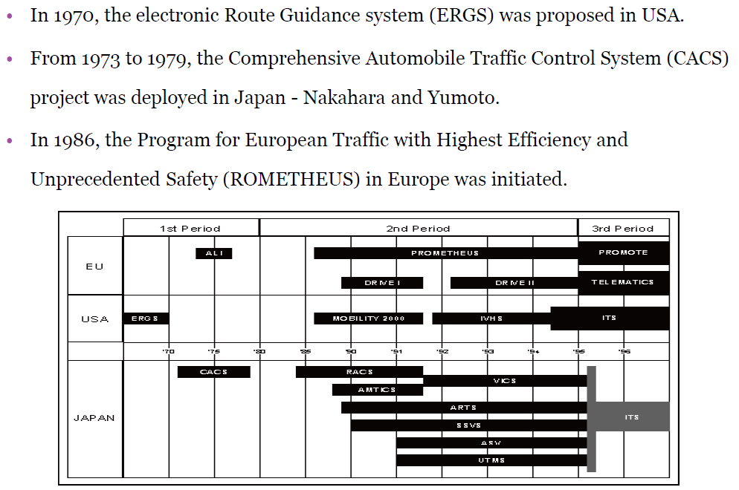
Deployment of VANET

Slide 50

Q&A

